Slide 1
Power plant Analysis Presentation Tilak kumar Bonala

Slide 2
Project analysis slide 2
Project Analysis
Problem
PROJECT
Description
ANALYSIS
CONCLUSION

Slide 3
Project analysis slide 3
Pudl data
MARKET ANALYSIS
TECHNICAL ANALYSIS
ECOLOGICAL ANALYSIS
FINANCIAL ANALYSIS
According to given data fuel cost variation depends on n numbers of factors which impacts the viablitilty of different rypes of generation results in competitiveness of renewable electricoty
From analysing data w.r.t fuel cost, we form different clusterswhich tells us about the data distribution
how operating cost affect individual power plants
How different types of fuel emissions effects the environment

Slide 4
Project analysis slide 4
Project Analysis
Clusters
interpretation
Data cleansing
Implementation (kmeans)
s
PUDL data
summary

Slide 5
Project analysis slide 6
Project Analysis
Data Preparation:
Data cleaning
Taking sample 2% of data for analysis
Splitting the data
Normalizing the data
Applying cluster analysis
Finding the best take taking different variables
Applied k-means for analysis
Validating the test data

Slide 6
Project analysis slide 5
Project Analysis
Using elbow method
K=3 ,
The best k from analysis is 3

Slide 7
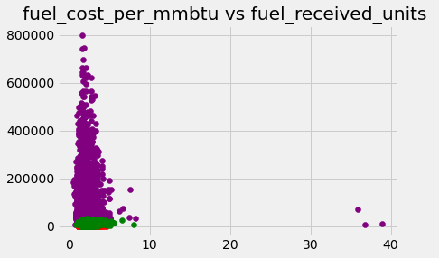
Project analysis slide 5
Project Analysis
Cluster 0 - purple cluster1- red cluster2- green

Slide 8
Project analysis slide 7
Project Analysis
Cluster 0 : More no. of companies receiving more fuel and low sulfur, ash, and low fuel price
Cluster1: less no. of companies receiving less fuel medium level of Sulphur, ash and with more fuel price
Cluster2: more than cluster 1, medium fuel import medium fuel cost, high contents of Sulphur and chlorine

Slide 9
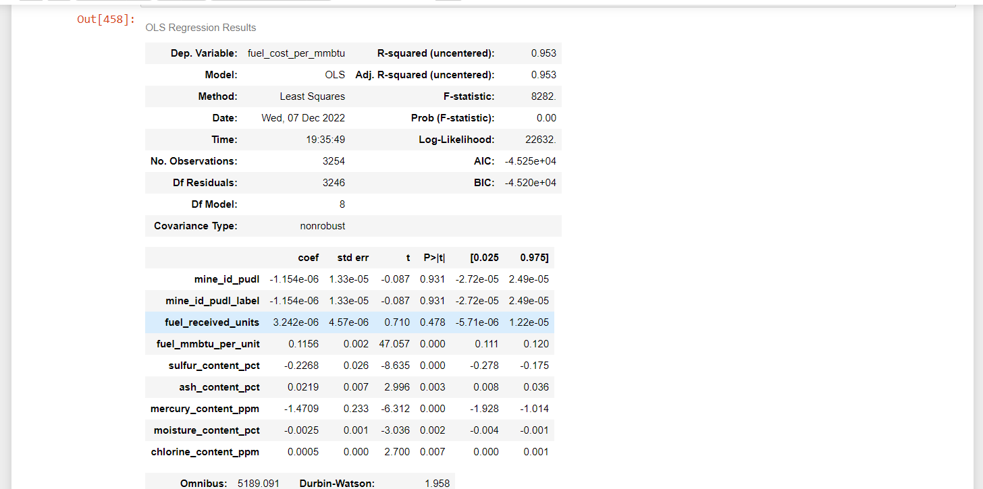
Project analysis slide 7
Project Analysis
Validating the test data variables with above model and finding the significant variables that affects the fuel cost.

Slide 10
Project analysis slide 8
conclusion
power plants in cluster 0 are performing well, with low operating costs and low emission of pollutants.
Power plants in cluster 1 operate at a high fuel cost and are moderately affected by the emissions of pollutants compared with the other two clusters.
In cluster 2, fuel operating cost is at a medium level for power plants and emissions of pollutants are high.

Slide 11
Thank You

